Slide 1
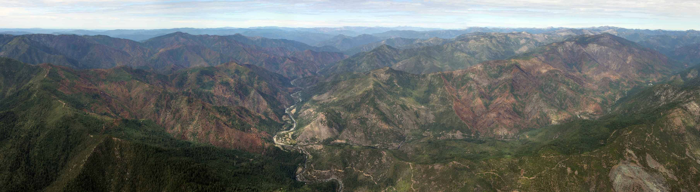
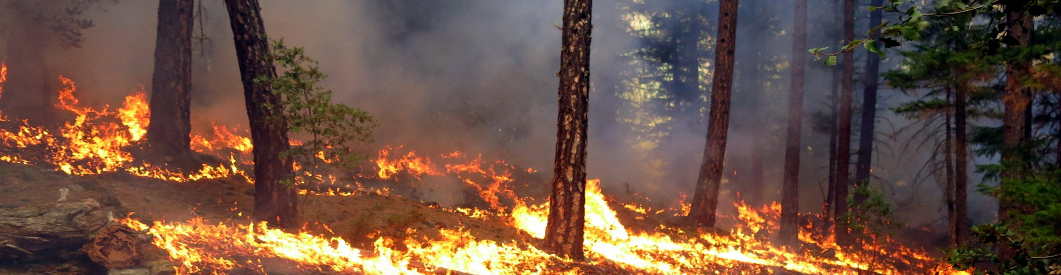
Western Klamath Restoration Partnership
Bringing Good Fire Back at the Landscape Scale
Notes:
I am here today to tell you a little about the Western Klamath Restoration Partnership, or WKRP, and why we are bringing good fire back at the landscape scale. I hope to provide a basic overview, summarize our fire issue, convey some general statistics, express urgency, identify challenges, begin to discuss solutions, and finish up with a couple priority issues that could use some attention.

Slide 2
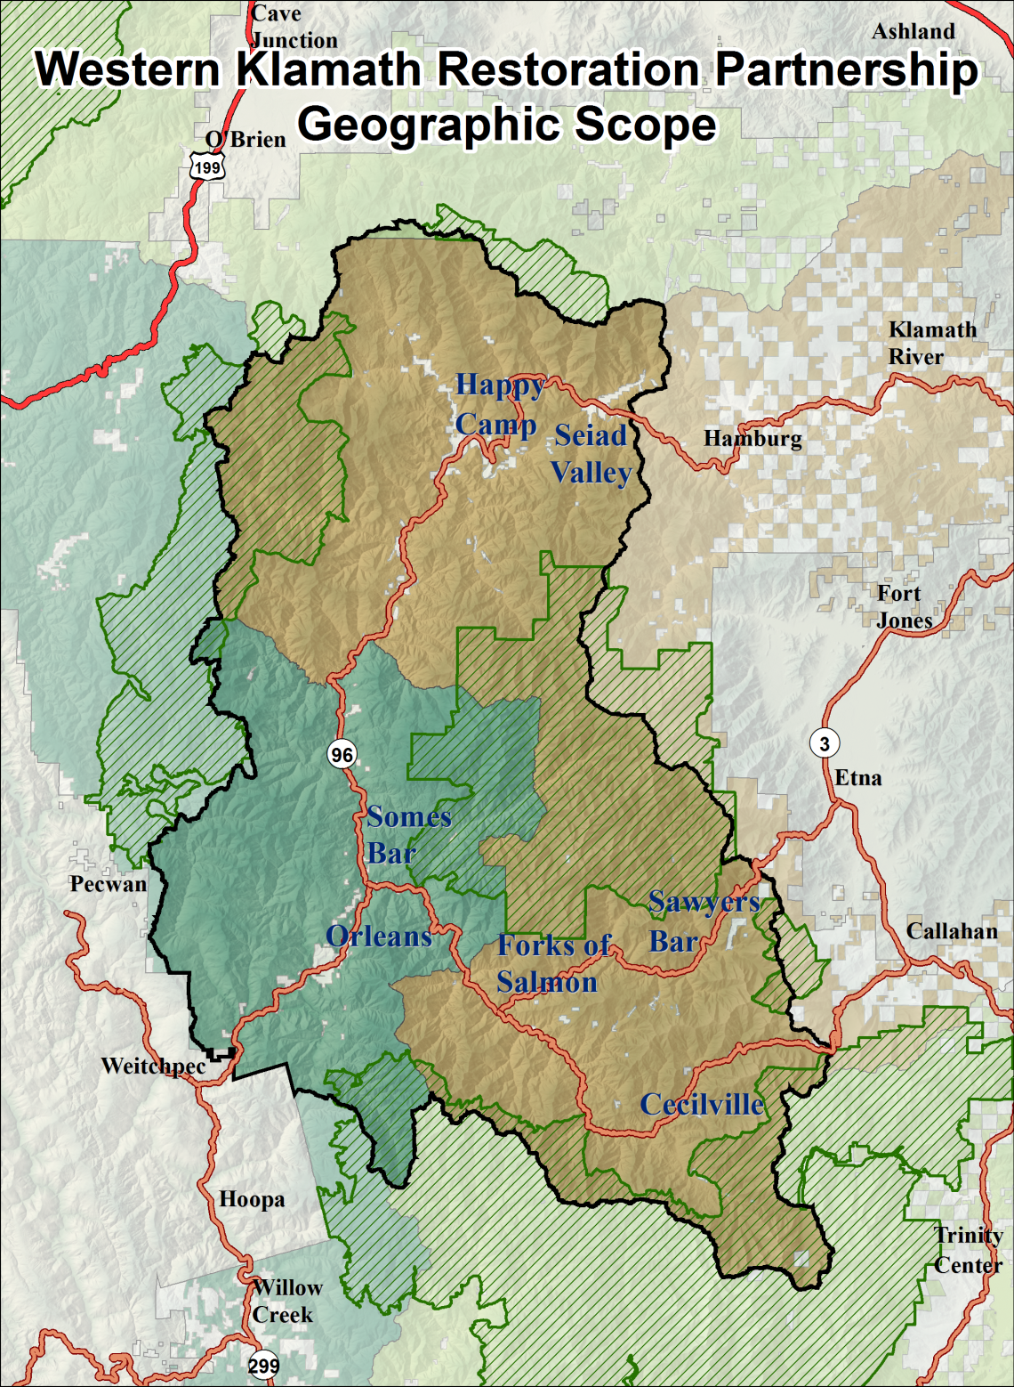
1,197,719 Total Acres
<2% Percent Non-Forest Service
68.5% KNF
29.1% SRF
86.7% Siskiyou
11.2% Humboldt
1.9% Del Norte
84% Karuk Aboriginal Territory
29.4% Wilderness
20.9% Roadless
5.6% HC FSC WUI acres
8.7% Seiad FSC WUI acres
5.9% OSB FSC WUI acres
11.2% Salmon R FSC WUI acres
10.9% Identified as Moderate to High priority for treatment.
Notes:
Our planning area is approximately 1.2 million Acres and includes seven communities at risk that are covered under four CWPP’s, a variety of tribal equivalent working documents, and two land and resource management plans. This is very much a fire prone landscape. The greater vision developed by the WKRP is stated as;
“Establish and maintain resilient ecosystems, communities, and economies guided by cultural and contemporary knowledge through a truly collaborative process that
effectuates the revitalization of continual human relationships with our dynamic landscape.”
As you can see this is a very large, very remote rural area, with plenty of overlap in regard to Federal, Tribal, State, local government, Non-governmental organization and community based interests.

Slide 3
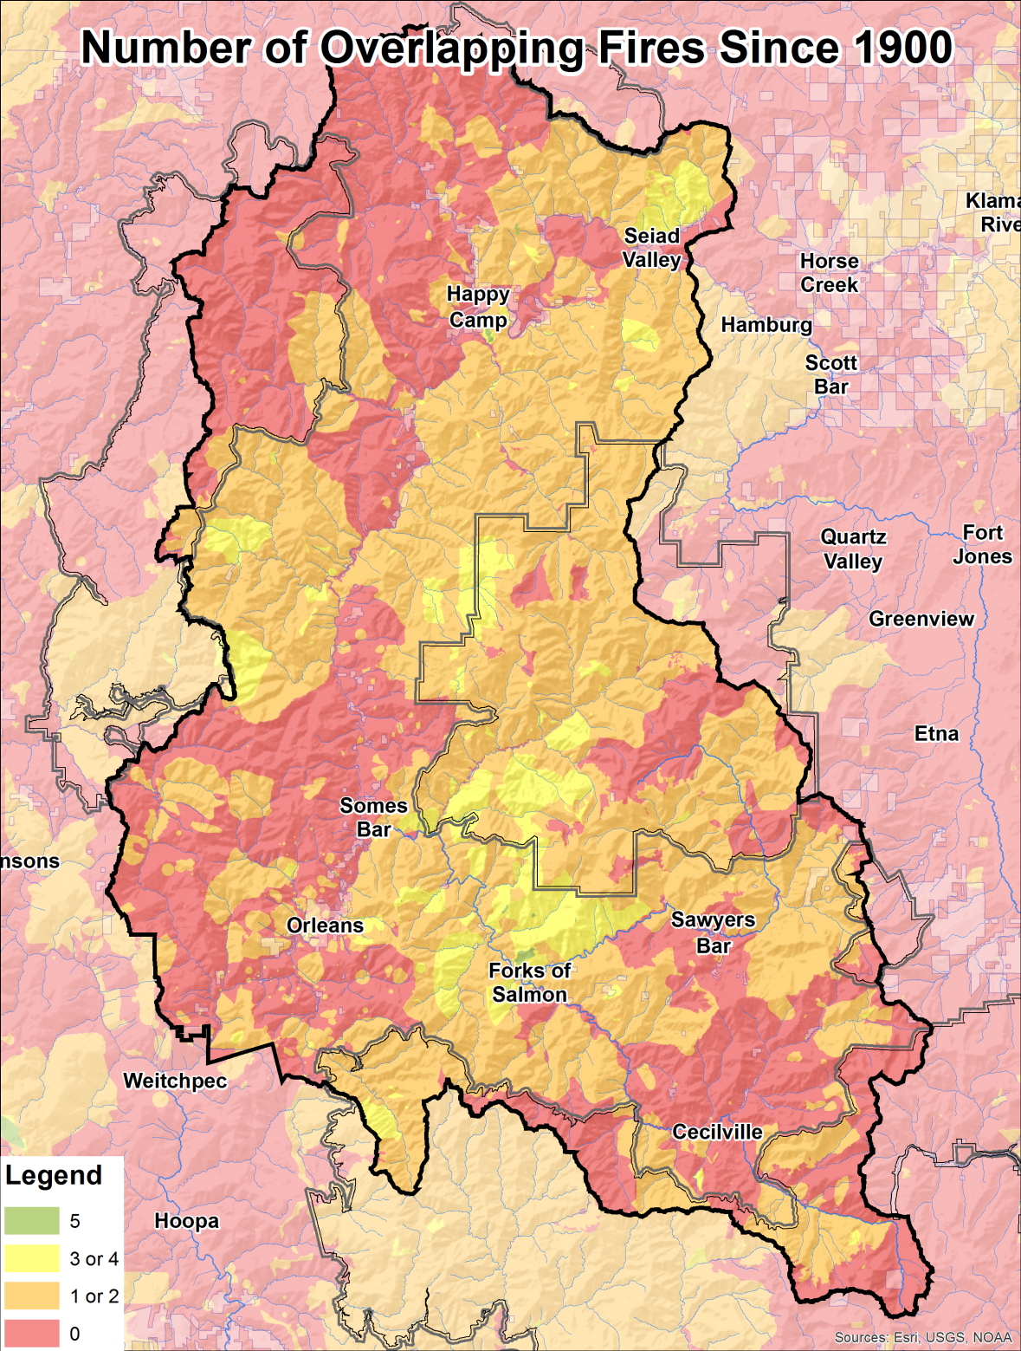
Lack of Fire on the Landscape
Burned Since 1900:
Acres (percent of WKRP Scope)
0 fires – 492,125 acres (41%)
1 fire – 413,355 acres (35%)
2 fires – 212,433 acres (18%)
3 fires – 71,191 acres (6%)
4 fires – 7,741 acres (0.6%)
5 fires – 853 acres (<0.1%)
6 fires – 22 acres (<0.002%)
Notes:
We have a severe fire deficit. Over a century of fire exclusion has turned vast areas that were once in a very frequent fire regime into a tinderbox set to burn during an unprecedented alignment of severe climate conditions and high fuel loading. For thousands of years this area has been maintained by regular cultural and natural ignitions, some of which are now missing over 100 cultural fire intervals. This is causing fires to increase in size, intensity and severity as can be seen in this next slide which will animate the recent progression of fire occurrence between the 2003 and 2014 fire seasons.

Slide 4
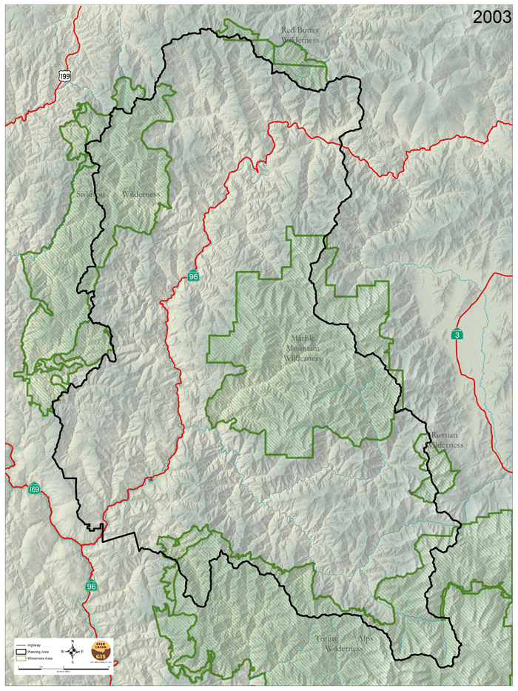
Increasing Scale and Severity of Wildfire (urgency)
Large fire footprints in the past 10 years offer an opportunity for fire regime restoration.
Large fires from 2006 and 2008 are quickly increasing in complexity of burn due to ingrowth and fuel loading
Climate change predictions project an increase in frequency and severity
The latest scientific evidence shows that we only have 9 to 12 years to get fire back in to these burned areas before risks start to increase rapidly
Notes:
Fires are rapidly increasing in size, are much harder to manage and are risking the lives of firefighters and the public. Yet every fire we put out; and don’t take every opportunity we have to put fire back in on our own terms; defers this risk to another fire event which may be during an even worse alignment of fuels and climate conditions. We can compartmentalize fire; we can manage most fire on our own terms; we have some challenges to overcome and some capacity to build, but the sooner we can test our zone of agreement in principle, and come to agreement in practice; the faster we can scale up with more tools at our disposal.

Slide 5
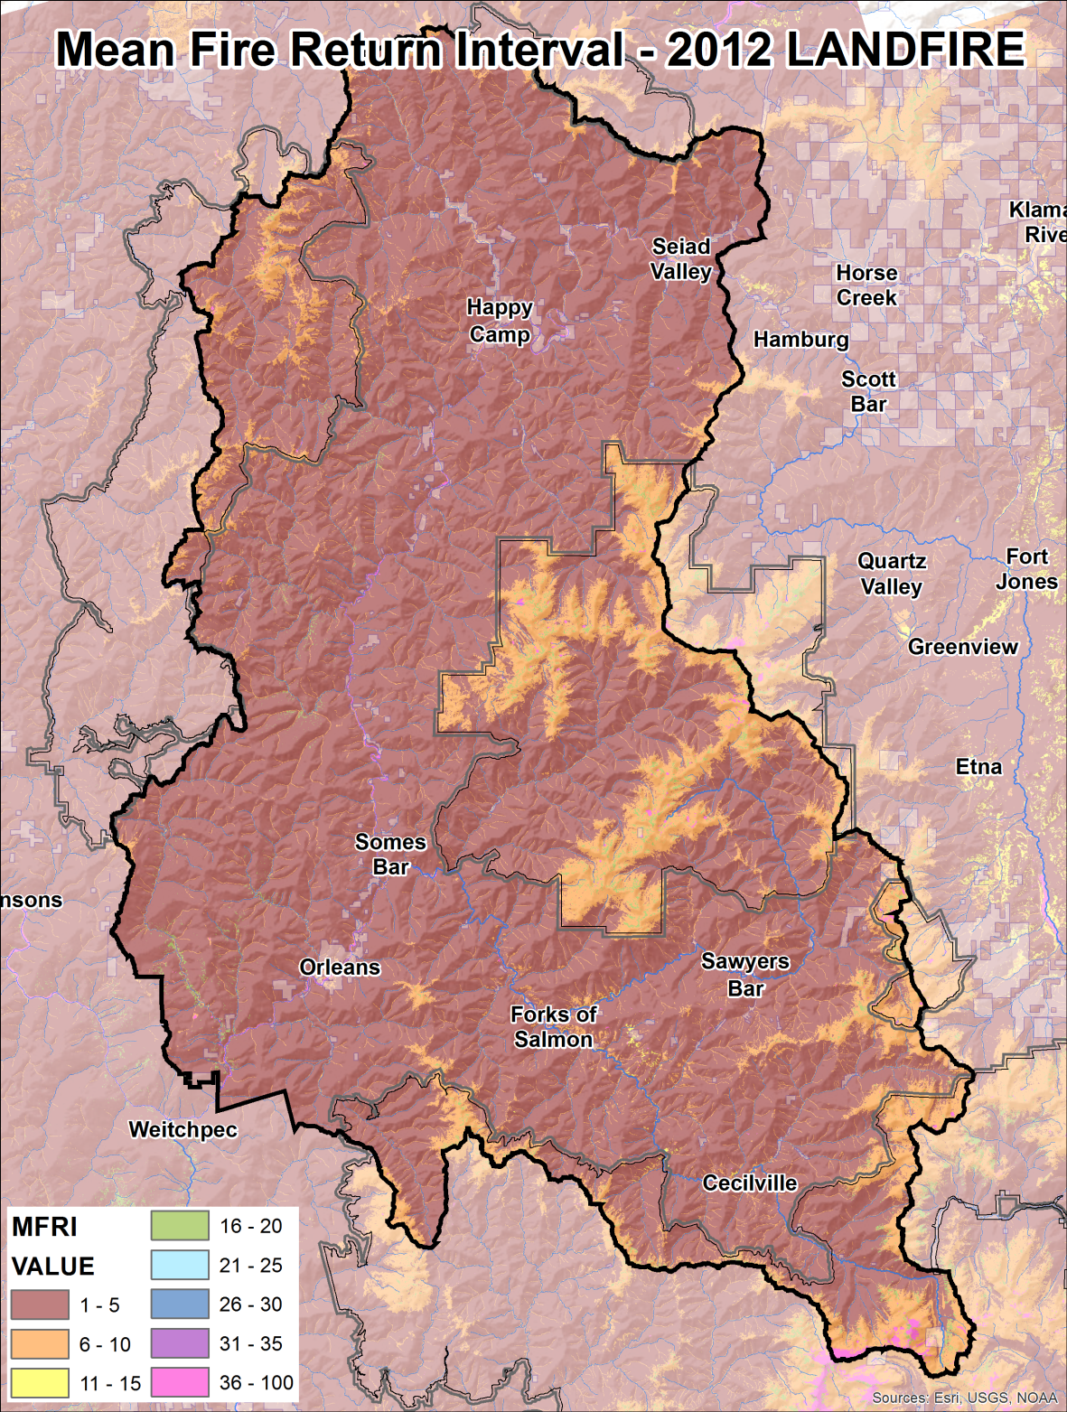
LANDFIRE Mean Fire Return Intervals
Most of area averaging a 1-5 year interval
Very high elevations averaging a 5-10 year interval
Very little in other categories
TEK and Cultural Fire Return Intervals
Ceremonial fires as an annual frequency
Other Anthropogenic fires primarily on a 1-3 year; 4-7 year; and 8-12 year frequency
Notes:
To provide further scale in regard to the fire deficit, 2012 LANDFIRE modeling shows that for most of this landscape we should historically see fire return at a 1 to 5 year average. This is a lot of fire with which to maintain the historic range of variability and subsequently the fire resilient conditions of one of the most ecologically diverse places on the planet.
This is consistent with what the Traditional Ecological Knowledge of the Karuk Tribe indicates, which places anthropogenic fire uses within a one to three, four to seven, or a eight to twelve year frequency in consideration of a plethora of factors such as place based responsibility, resource quality and quantity, seasonality of burn, aspect, elevation, landscape position and location of lightning ignition relative to permanent human inhabitance, etc.
Other sources of relevant scientific information such as research papers, journal articles, peer reviewed literature, and the preliminary findings of ongoing study also support this story. But in reality only the continual practice, observation, adaptation, and intergenerational knowledge conveyance of a people of place can ultimately overcome the dilemma.

Slide 6
Challenges
Limited Capacity for Focused Tribal Consultation in the Formulation of Statutory Law, Regulation, Policy, and Program Administration
Lack of Qualified Leadership, Support, and Workforce Capacity to Enable Collaborative Growth of Practice to Scale
Inconsistent and Fragmented Forest Plan Direction
Initial Response Resources Still Pressured to Keep Fires Small and Unable to Change Management Actions as Conditions Change
Lack of Lasting Institutional Capacity and Rapid Assessment Tools
Lack of Workforce Housing, Transportation, Apparatus and Multi-Organizational Facilities Infrastructure
Economic Gain Seems to Have Priority Over Social and Ecological Benefits
Response Actions not Consistent With Strategic Approach
Lack of Parity Among Federal, Tribal and State Sovereigns in the Administration of Applicable Programs
No Distinction Between Prescribed Fire, Cultural Burning, and Anthropogenic vs. Natural Emissions Classification
Notes:
We face many obstacles, but I believe that in overcoming these key challenges we can effectuate the revitalization of continual human relationships with our dynamic landscape as intended by our collaborative vision. This is not an exhaustive list by any standard, but with some prioritized focus in these areas we should be able to grow out solutions, increase place based capacities, meet fiduciary trust and/or treaty obligations, and replicate adaptable approaches in fire prone rural landscapes.

Slide 7
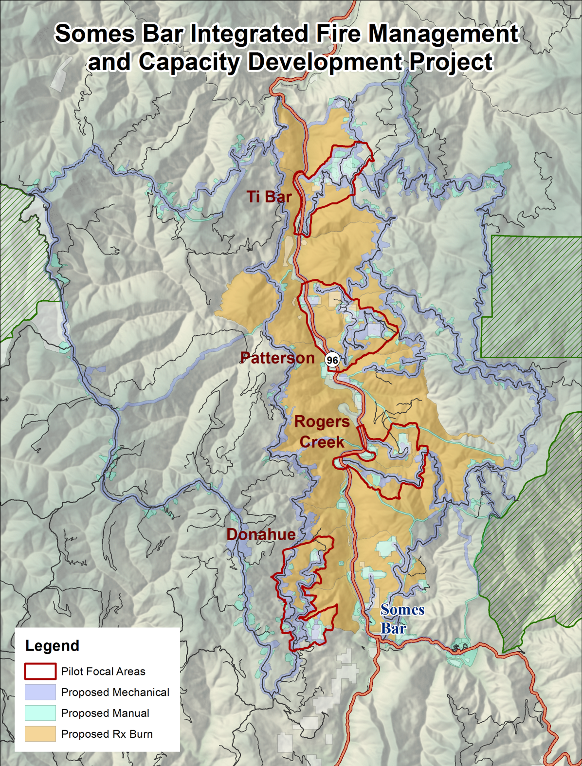
Agreement in Principle
3,456 acres Mechanical Treatment
3,440 acres Manual Treatment
10,342 acres Mechanical and/or Manual Treatment
Totaling 17,239 acres potential pre-burn treatments
25,674 acres potential Prescribed/Cultural Burn Treatment
Pilot Project Planning Area Approximately 100,000 acres
Phase I Focal Areas 6,480 acres targeted for NEPA coverage
Notes:
We plan on overcoming these challenges by piloting three projects in our planning area. The Somes Bar Integrated Fire Management and Capacity Development Project; the Salmon River Integrated Large Fire Management Project; and the Happy Camp Integrated Community Protection and Workforce Development Project.
We have started collaborative pre-scoping for the Somes Bar Pilot Project which is reflected in this slide. Our original Agreement in Principle identified approximately 50,000 acres of potential mechanical, manual, and prescribed fire treatments. But in realizing some significant limiting factors we narrowed our initial actions to a set of four focal areas totaling approximately 6,500 acres. By starting at this smaller scale, we plan to take our agreement in principle, demonstrate a variety of treatments, and achieve agreement in practice. Ideally this process will inform collaborative input into and Tribal Consultation for Land and Resource Management Plan revisions to achieve consistency across Klamath, Six Rivers, and Shasta/Trinity National Forest boundaries and enable us to scale up to plan and implement the larger project in phase two.

Slide 8
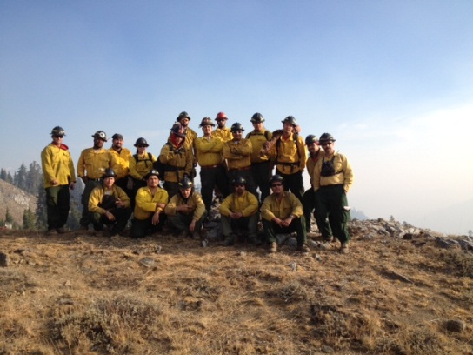
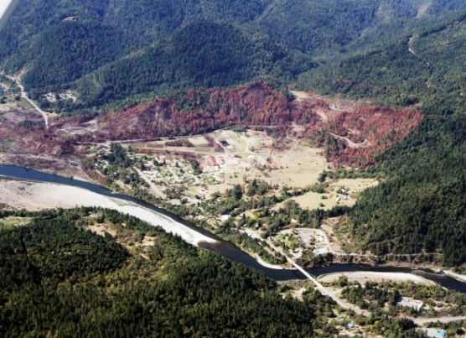
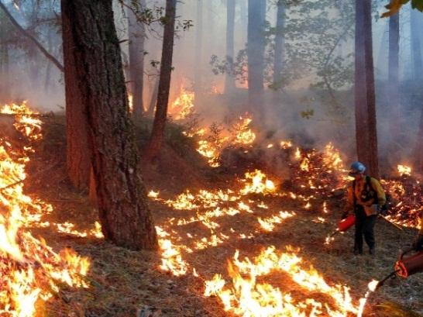
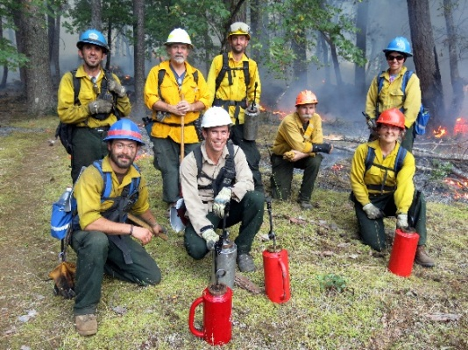
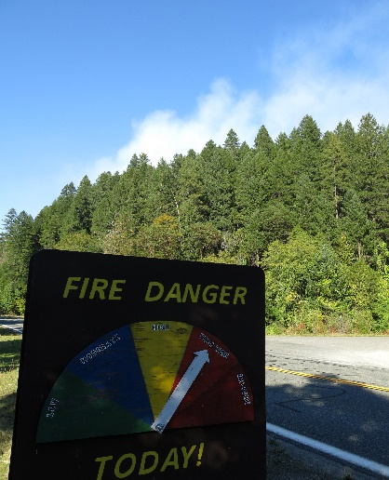
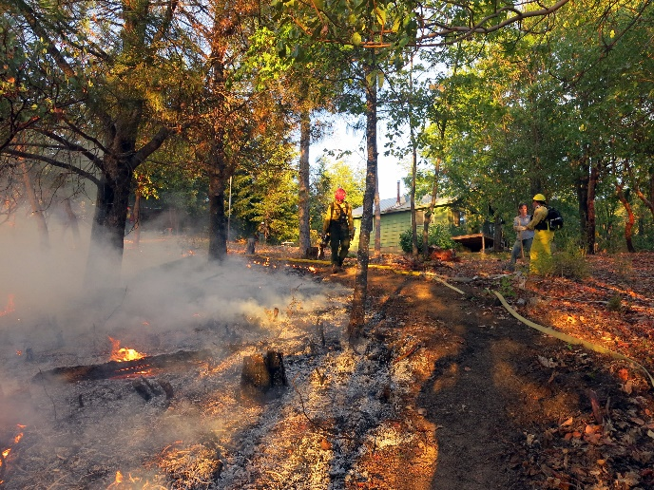
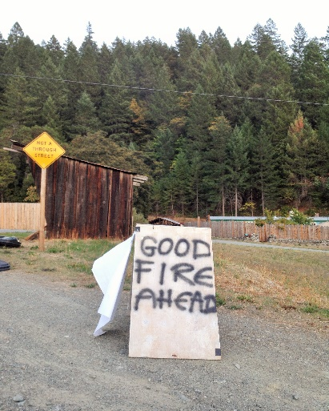
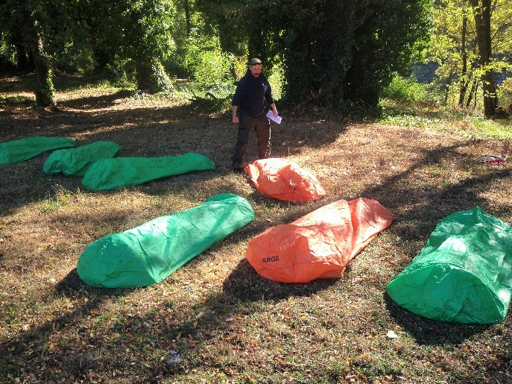
Integrated Collaborative Capacity Development Concepts
(K1 photo)
Short Term
Temporary Work Force Housing
Prescribed Fire Training Exchange (TREX)
Collaborative Type 3 Incident Command Team(s)
Multi-organizational Leadership and Support Positions
NEPA Specialists
Technical Staff
Analytical Tools
Local Youth Corps
Long Term
Adaptive Management Field Institute w/
Integrated Fire Management Training Center
Expanded Agreements with State and Federal Agencies
Reliability of Compacted Programs
Diversified Revenue Streams
Expedited Training for Fire Management
Integration of Multiple Research University Program Support (social, ecological, economic, and climate fields)
Notes:
In order to instill Cohesive Strategy behaviors into the all hands, all lands fire management culture, well trained capacity will be paramount, locally, regionally and nationally. Both short term and long term tracks are occurring simultaneously, though at a pace only a handful of people can progress. Complete integration of adaptive management planning, implementation, monitoring, research, training, Kindergarten through grad-student education, and specialized mentoring are the conceptual goals of this Integrated Collaborative Capacity Development Approach. Cultural Burning, Prescribed Fire, and Managed Wildfire, NWCG, NIMS, and 401 series classes would all be coordinated under Interagency Fire Program Management Guidelines to help meet National Incident Management Organization successional staffing needs.
If this can be done anywhere, it can be done in the Western Klamath Mountains. These concepts could be replicated, adapted, and carried out in other strategic locations across the West. There are programs out there that focus on prescribed fire, or the hotshot model which teaches the full suppression paradigm; but only one of these are a Tribal Program, and none of them have integrated the full potential that the Cohesive Strategy intends to enable. So lets start now, lets train the trainers of tomorrow. The Somes Bar Integrated Fire Management and Capacity Development project just happens to be on the Ukonom Ranger District in the Karuk Center of the world; where there are progressive Forest Service Staff willing to take an innovative approach; where Managed Fire is actually allowable; and where it will help the Karuk people revitalize our ceremonial burning practices and enhance our subsistence use resources and perpetuate our living culture.

Slide 9
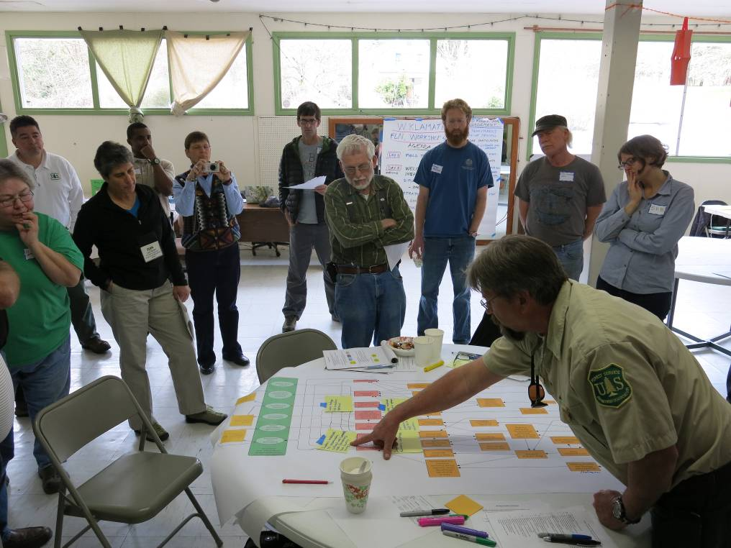
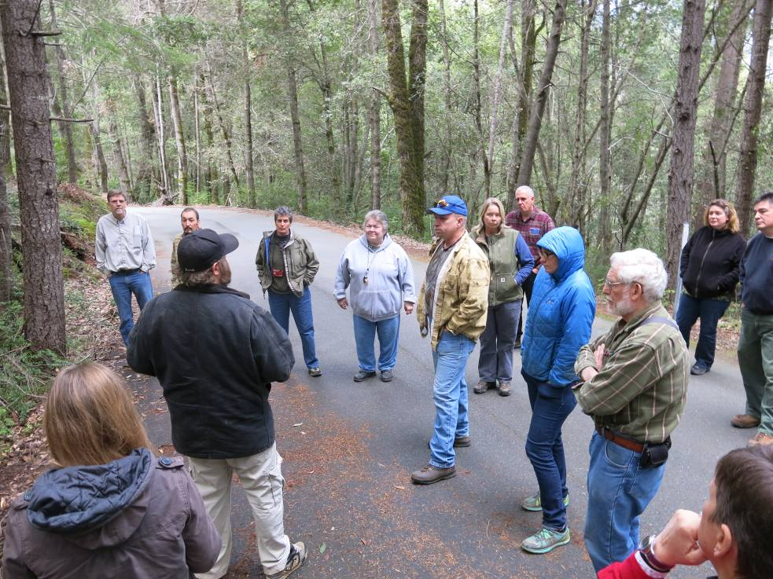
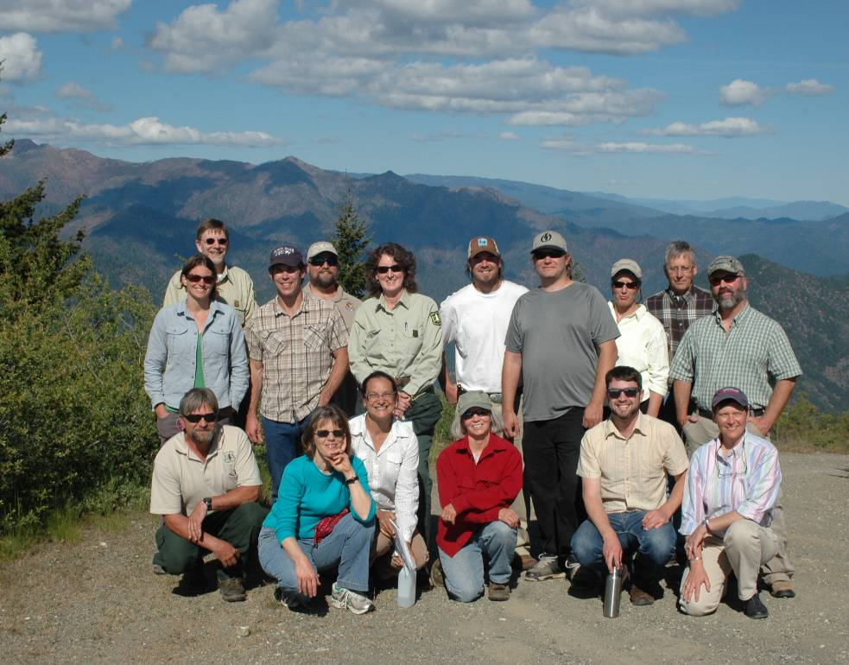



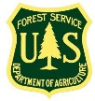
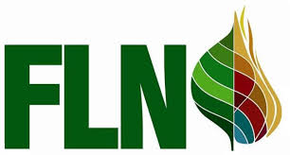

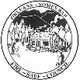
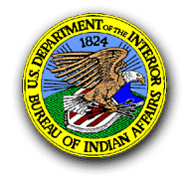




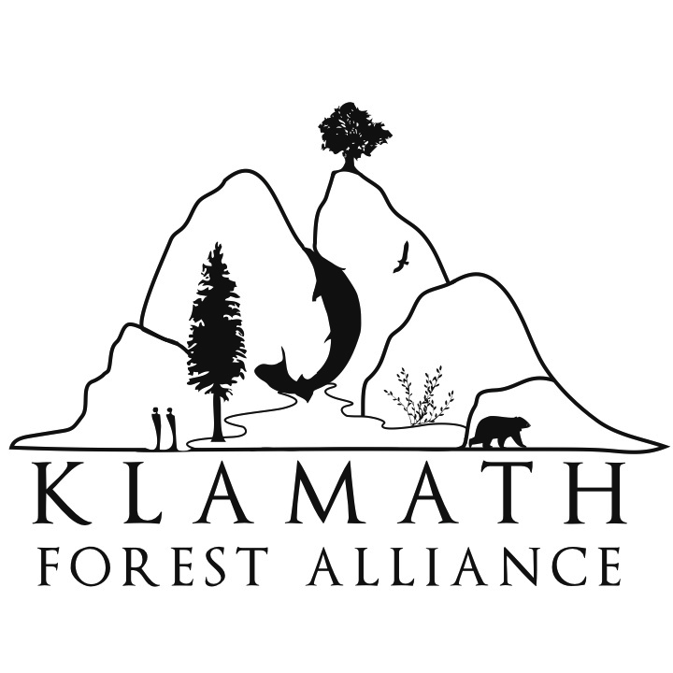
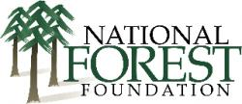
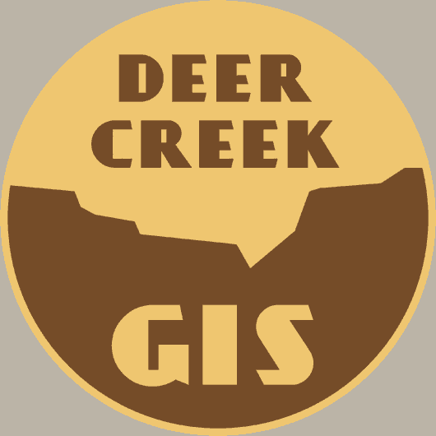
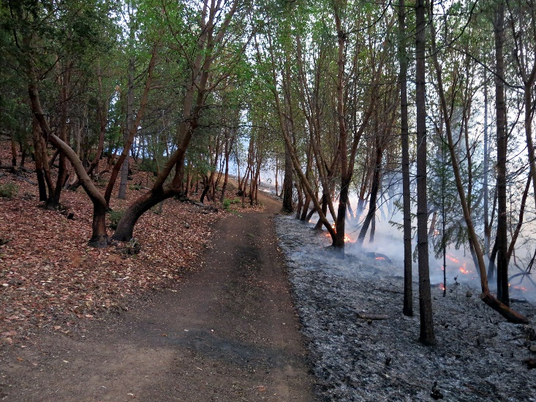
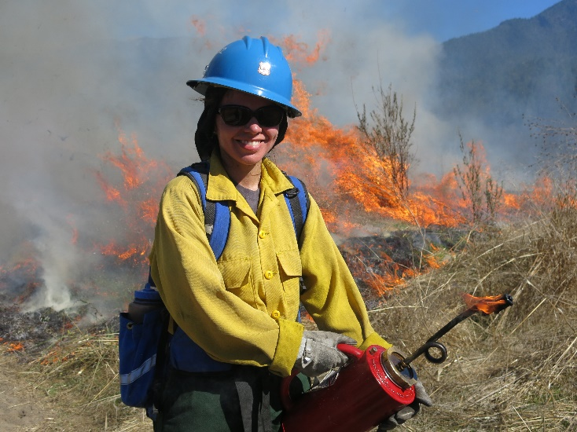
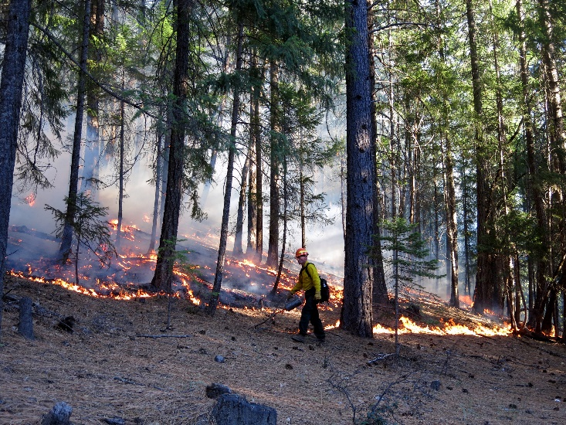
Western Klamath Restoration Partnership
Thank
You

